Slide 1

Emergency Vehicle Enrouting
Team:Tranporters

Slide 2
Team : Transporters
Group Members :
Prachi Barache
Ganesh Bhise
Jay Rawlani
Keshav Bajaj
Raj Awate
Atharva Temkar.

Slide 3
Content
Introduction
Domain Selection
Probable problem statements
Probable Solutions
Actionable solutions
Actionable statement
Survey
Ideation

Slide 4
Introduction
In first week , We were introduced to the theme “WARI”
We were introduced to spot and probe

Slide 5
Domain selection :
We have started with spot process!
And we came across following domains :
Pollution
Food
Health care
Traffic management
Crowd
Waste Management
Electricity distribution
Accommodation
Parking
Out of which we found out we chose the traffic management domain.

Slide 6
Probable problem statements
In traffic management domain also we spotted following sub-domains:
PMPML Traffic
Wari traffic
Local vehicles
Visitors traffic
Emergency vehicles :
Police vehicles
Ambulance
Fire Brigade

Slide 7
Probable solutions
Displaying PMPML Schedule by using real time monitoring system.
Managing PMPML Traffic using Image Processing.
Guiding Dindi vehicles to their destination.
Avoid accidents by using sensors
Traffic road clearance system for emergency vehicles using optical communication system.

Slide 8
Emergency Vehicle Enrouting
-Actionable Statement

Slide 9
Survey
Meeting with stakeholders:
Temple Authorities
Hospital authorities
Police authorities
Ambulance Stop
Ambulance rout
Ambulance destination

Slide 10
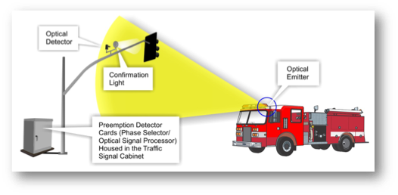
Ideation
Traffic signal control using Optical communication
Routing Emergency vehicle

Slide 11
Optical Transmiter
Communication Channel
Optical Receiver

